Slide 1
University of Bremen Summer Research Internship Program
Peter Haddawy
Mahidol-Bremen Medical Informatics Research Unit
Faculty of ICT
Mahidol University

Slide 2
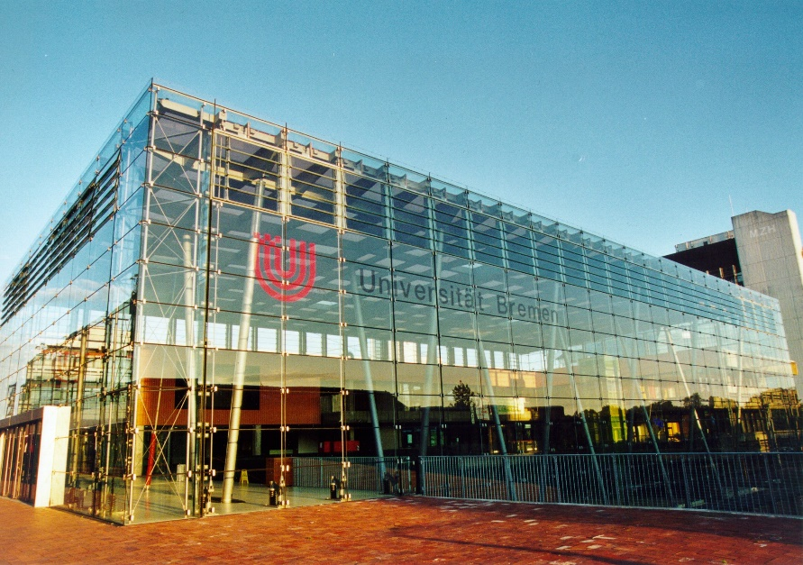
General Information
Tentative dates: May 16 – Aug 8 (12 weeks)
About 20 students
2nd, 3rd ,and 4th year Undergrad, MS, PhD
CGPA ≥ 3.0
Scholarships available on a competitive basis
Particularly interested in
Students whose internship is linked to their senior project
Students who want to publish their work
Required to be vaccinated with a COVID vaccine accepted in Europe
Recommend getting a booster before traveling if possible; otherwise can get in Bremen

Slide 3
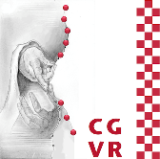
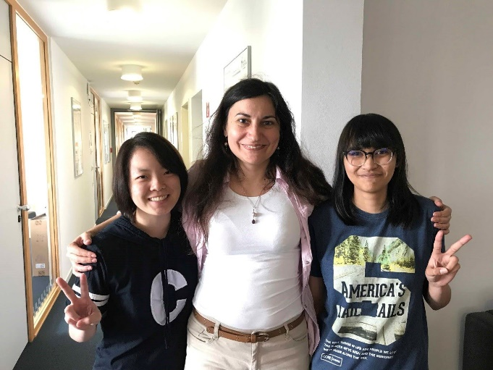
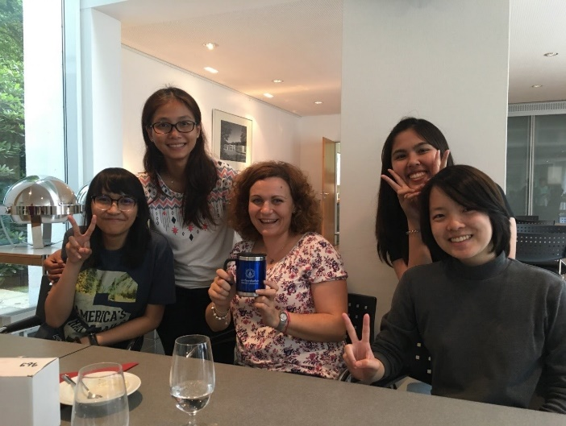
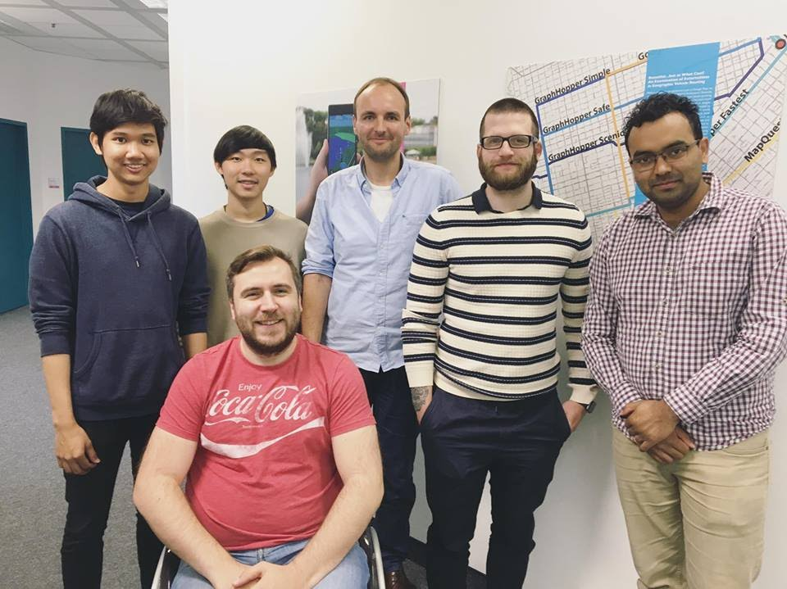
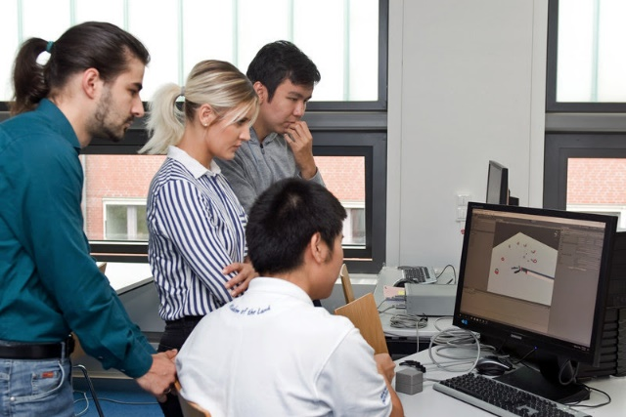
Six Labs
Bremen Spatial Cognition Center
Computer Graphics and VR
Communications Networks
Digital Media
Inst. for AI (Robotics)
Software Engineering
Digital Media Lab
Software Engineering Lab

Slide 4
Projects from previous batch | Student(s) | Lab
i-CollDet: An interactive web app for collision detection benchmark and visualization | Waralee Tanaphantaruk, Issawat Nilavongse | Computer Graphics and VR
Haptic VR Cardio Vascular Access Training Simulator | Krongpong Monpengpinij | Computer Graphics and VR
The Effect of Dramatic Elements in Educational Serious Games | Pantita Wang | Digital Media
Localization of Input Devices in a Virtual Training Game for Surgeons | Kiettikoon Amornrat | ComNets
Human mobility tracking and malaria infection | Chaitawat Sa-ngamuang | Bremen Spatial Cognition Center
Music Recommendation based on DJ Sets and Features from the Recording Studio | Pattararat Kiattipadungkul, Tanyarin Karuchit | Bremen Spatial Cognition Center
Audio vs Visual: Guiding Technique for Caniotomy | Nuttawut Nuchprayoon | Bremen Spatial Cognition Center
Spheres2Mesh: Reconstruction of Sphere-packed Virtual Tooth | Tanakitti Sachati, Sirichoke Yooyen, Teerakarn Boriboonsub | Institute for AI
iClones incremental by machine learning | Vara Aramongkolvichai | Software Engineering

Slide 5
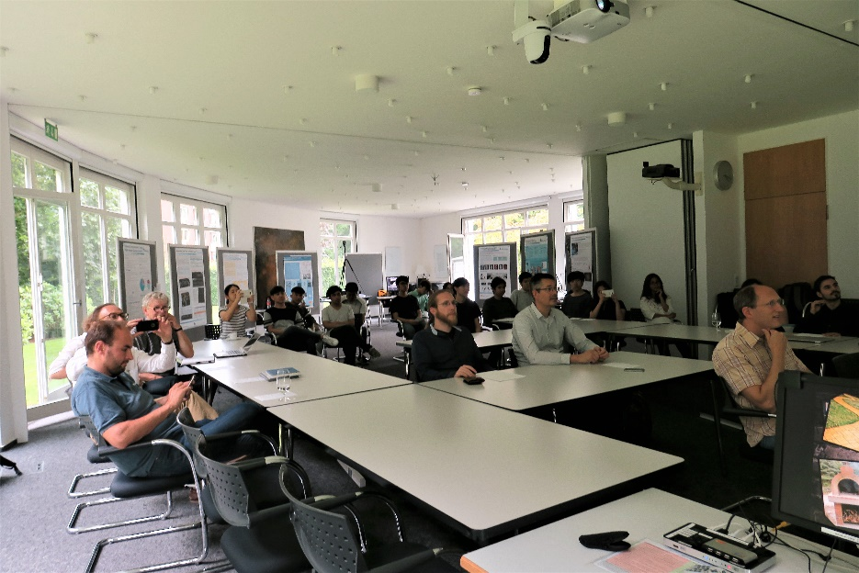
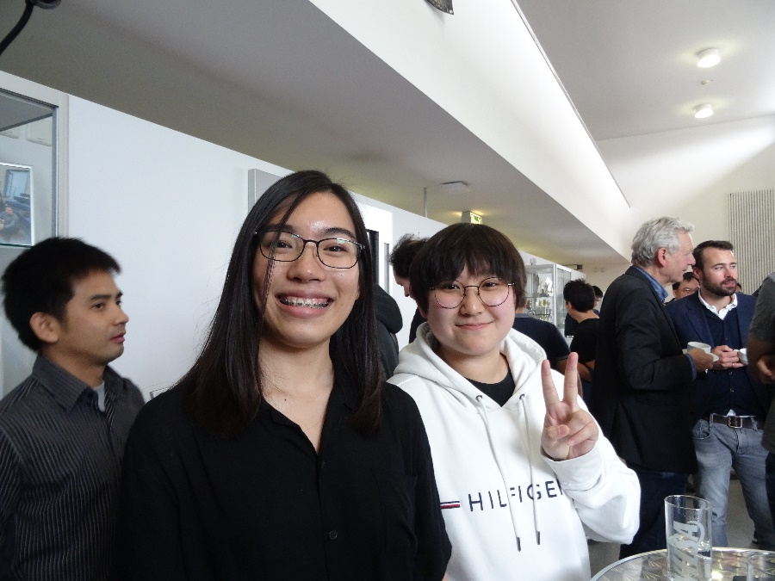
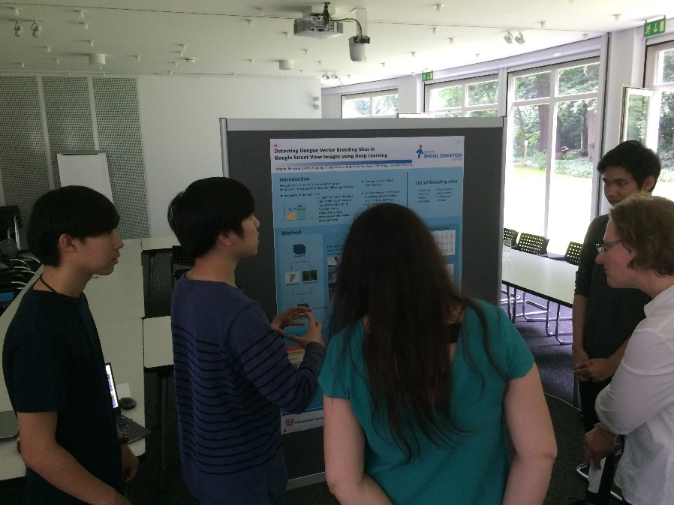
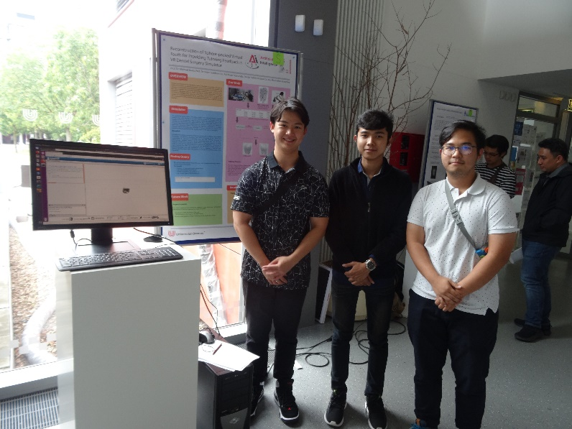
Summer Student Research Symposium

Slide 6
Process
You submit an application
Interviews held in February
All materials sent to Bremen
Heads of labs select students based on interests and skills
Scholarship recipients selected based on merit and senior project linkage
Offers made in late Feb/early March

